Slide 1

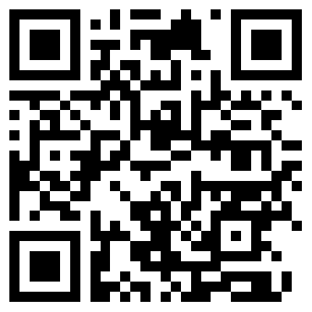


How Learning Assistants Behave During Prep Sessions
Marshall Adkins¹, Austin McCauley², Dr. Eleanor Close², Dr. Steven Wolf¹
¹ East Carolina University Department of Physics, ² Texas State University Department of Physics

Slide 2
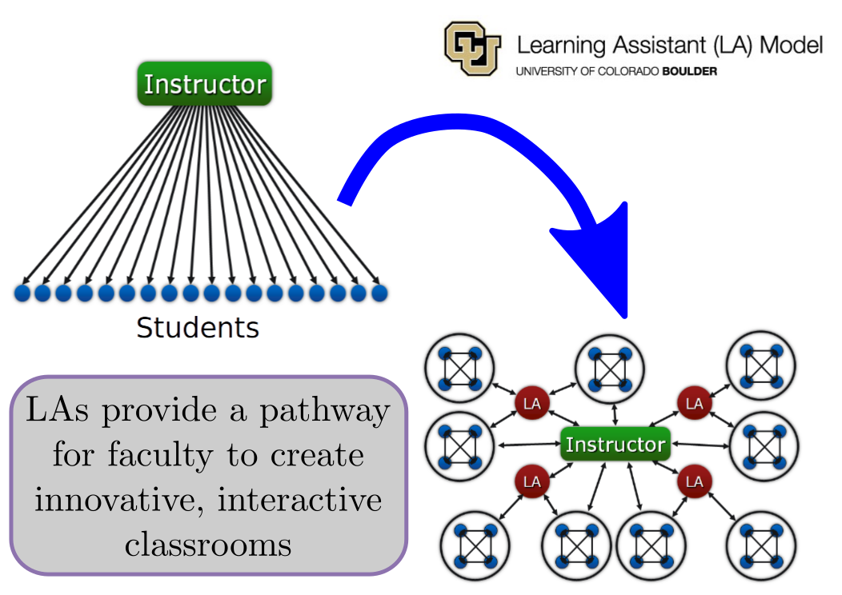
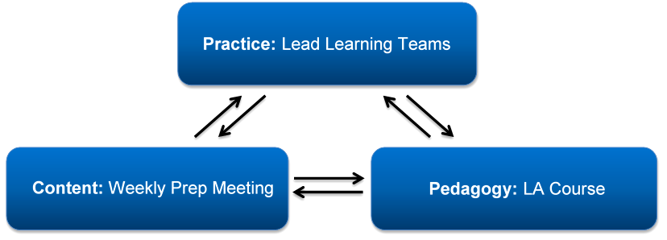

WHATS A LEARNING ASSISTANT (LA)?
LA Mission:
To facilitate an active style classroom
Lead to more student-student interactions
LA Procedure:
3 components to the LA Program:
Practice: The act of facilitating active learning in classroom
Pedagogy: Learning teaching skills to implement in classroom
Content: Weekly prep meetings to cover material going to be covered in class that week

Slide 3
Context
Observing Learning Assistant preparatory sessions
Video database contain over 500 hours of prep sessions
Videos were taken at Texas State University
Spanning across 3.5 years
Prep Sessions are held once a week, with 3 tables per week

Slide 4
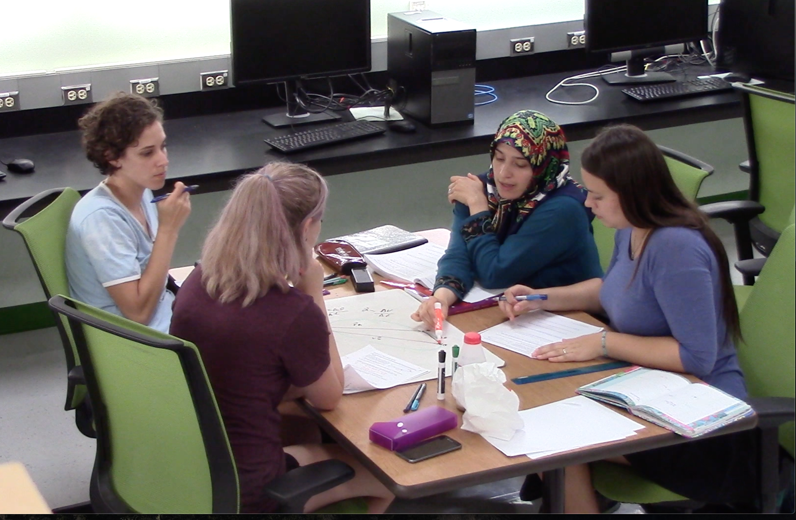
Research questions
What behaviors can be observed in LA prep sessions?
How can we quantify communication patterns?
How do behaviors influence communication patterns?
Student 4
Student 1
Student 2
Student 3
Behaviors
Communication Patterns

Slide 5
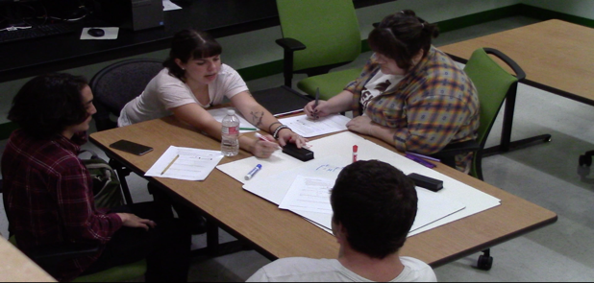
Behavior: Group Discuss
Students are discussing the activity/LA tasks

Slide 6
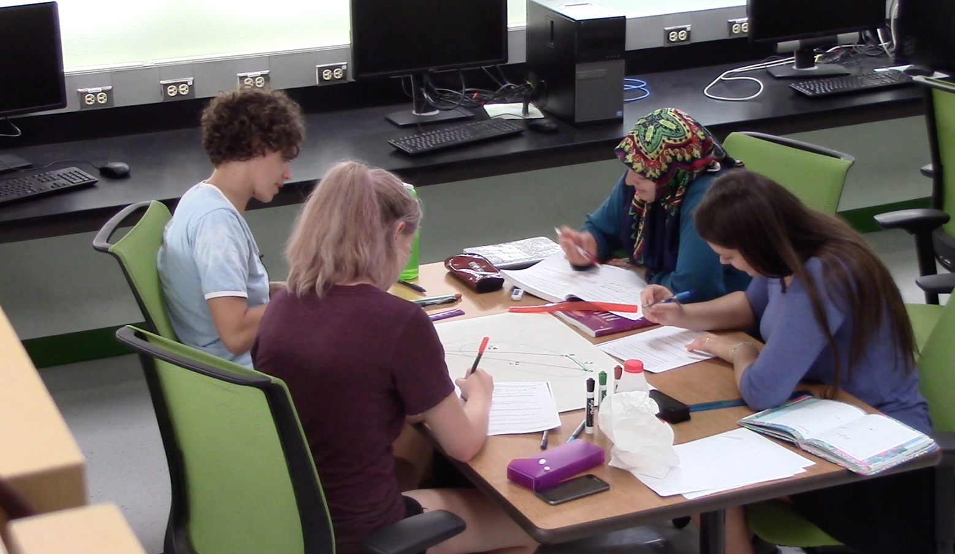
Behavior: Separate Work
Students are working on the task individually (includes things like writing in their packet)

Slide 7
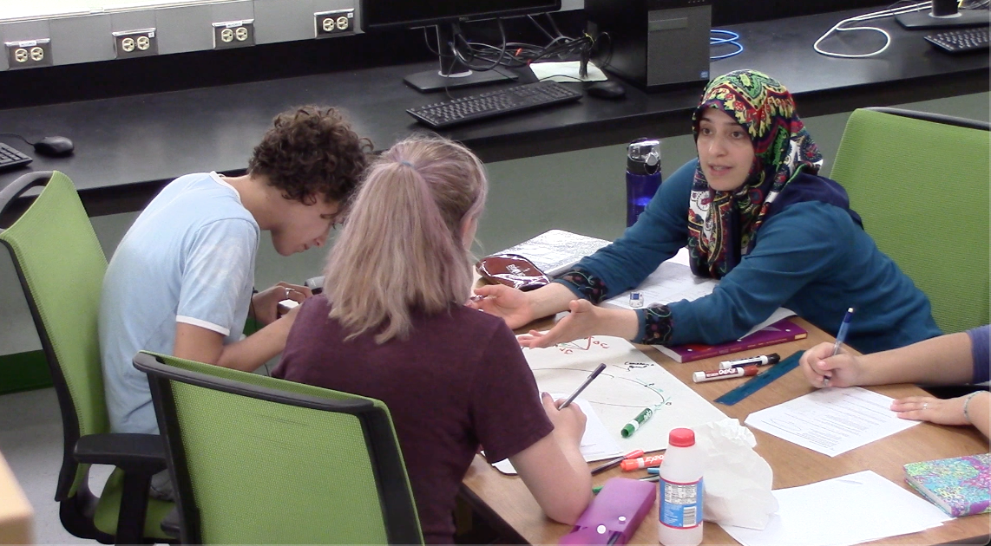
Behavior: Split Group
The table is split into 2 groups, the smallest group most be no smaller than 2 LAs

Slide 8
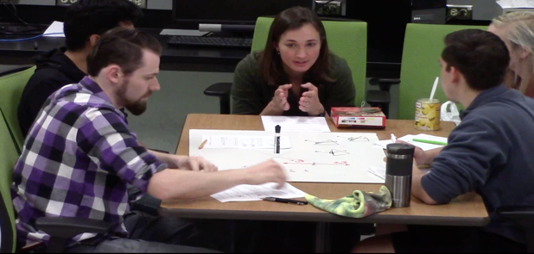
Behavior: Instructor Discuss
Instructor and Students are discussing the activity/LA tasks

Slide 9
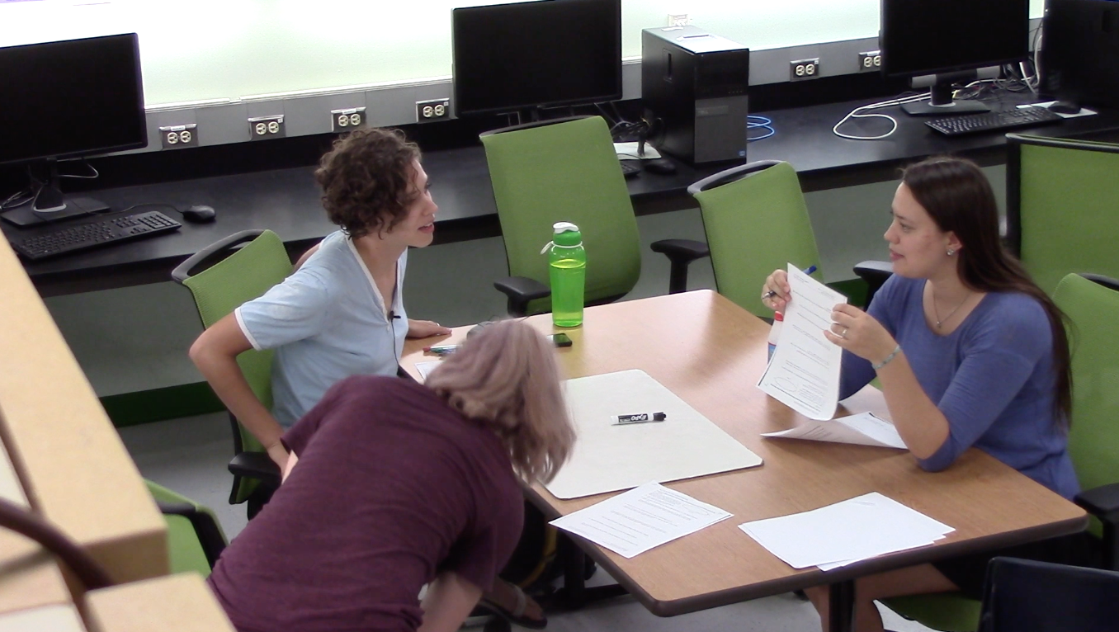
Behavior: Socializing
Students are discussing some topic unrelated to the activity/LA tasks

Slide 10
Behavioral Analysis
For each 15 second segment of video, the behavior the group exhibited would be marked down in an excel sheet
Used 2 coders, one from East Carolina University and one from Texas State University
Used an Inter-Reliability Rate (IRR) to ensure uniformity in results
Average IRR was --%

Slide 11
Conversational Code
Using the coded behaviors, we can observe the flow of information and conversation during these prep sessions
Can be used to tell us how to effectively guide the conversations of LA’s during prep sessions to lead to better outcomes in the classroom

Slide 12
Conversational Code Results
Only one video has been coded
Goal is to form multiple conversational Networks

Slide 14
Future of Research
Continue to code behavioral analysis of prep sessions and analysis the % time spent in each behavior
Create more Conversational Networks, and see how different behaviors influence the shape of the network
Long term goal is to determine how to best facilitate these prep sessions to see the best results in the classroom, making efficient and effective LA’s

Slide 15
Questions?
Thanks for your attention

